Slide 1
REST API

Slide 2
REST API
REST stands for representational state transfer
REST API is a way of accessing the web services in a simple and flexible way without having any processing.
It uses HTTP protocol for data communication.

Slide 3
HTTP Methods
The primary or most commonly-used HTTP methods are POST, GET, PUT, and DELETE. These methods correspond to create, read, update, and delete (or CRUD) operations, respectively.
GET - To fetch data from the server
POST - To Create a data in the server
PUT - To update a data in the server.
DELETE - To delete a data from server.

Slide 4
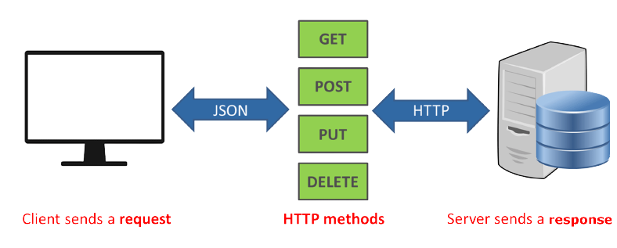
Working

Slide 5
BENEFITS OF REST
A primary benefit of using REST, both from a client and server's perspective, is REST-based interactions happen using constructs that are familiar to anyone who is accustomed to using the internet's HTTP.
HTTP Status Codes :
404 - requested resource wasn't found
401 - means the request wasn't authorized
200 - means everything is OK,
500 - there was an unrecoverable application error on the server

Slide 6
THANKYOU

